Slide 1
St Monica’s PSHE & RSE

Slide 2
PSHE & RSE at St Monica’s
Intent
At St Monica’s, we aim to deliver a PSHE curriculum, which enables all pupils to know more, remember more and understand how to play a positive and successful role in society. . It will help them to understand how they develop personally and socially, while tackling many social, moral and cultural issues that are part of growing up. We provide opportunities for the children to learn about rights and responsibilities and equip them to make choices as they grow.

Slide 3
Implementation
At St Monica’s, we hoped that our overall curriculum is designed to support the pastoral education for our pupils as well as the academic outcomes. Our curriculum covers the three PSHE core themes of Health and Well-being, Relationships and The Wider World.
Following the statutory curriculum, teachers use our curriculum overview for each year group to plan and deliver weekly lessons, supported by a variety of resources. In addition, there are occasions where teachers feel it may be necessary to teach PSHE as a result of an issue arising in their own class.

Slide 4
Impact
Our children will become healthy and responsible members of society, equipped with the knowledge and skills to make the right choices in society. They will demonstrate and apply the British Values of Democracy, Tolerance, Mutual Respect, Rule of Law and Liberty, alongside our Christian Values.
We want our children to display a healthy outlook towards school and their learning, to enable good attendance and achieve age related expectations. For all children to be on a journey preparing them for life and work in modern Britain.

Slide 5
National Curriculum
Personal, social, health and economic (PSHE) education is an important and necessary part of all pupils’ education. All schools should teach PSHE, drawing on good practice, and this expectation is outlined in the introduction to the proposed new national curriculum.
PSHE is a non-statutory subject. To allow teachers the flexibility to deliver high-quality PSHE we consider it unnecessary to provide new standardised frameworks or programmes of study. PSHE can encompass many areas of study. Teachers are best placed to understand the needs of their pupils and do not need additional central prescription.

Slide 6
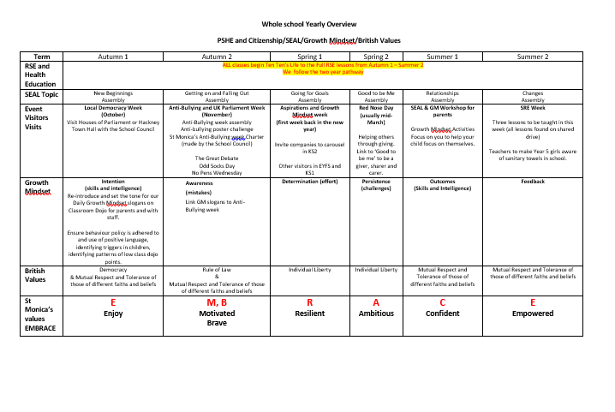
St Monica’s PSHE Overview

Slide 7
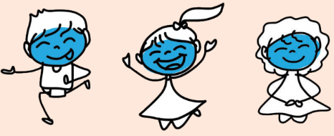
RSE at St Monica’s
At St. Monica’s, we use the Ten Ten Life to the Full programme to support our children in their knowledge of who they are in God and their relationships.
By using this programme, we hope that your pupils, staff, parents and wider community will not only have high-quality RHE but also a rich foundation for growth, personal development and happy, fulfilled relationships.
Life to the Full is a Relationships and Health Education curriculum programme underpinned by a Christian faith understanding that our deepest identity is as a child of God – created, chosen and loved by God.

Slide 8
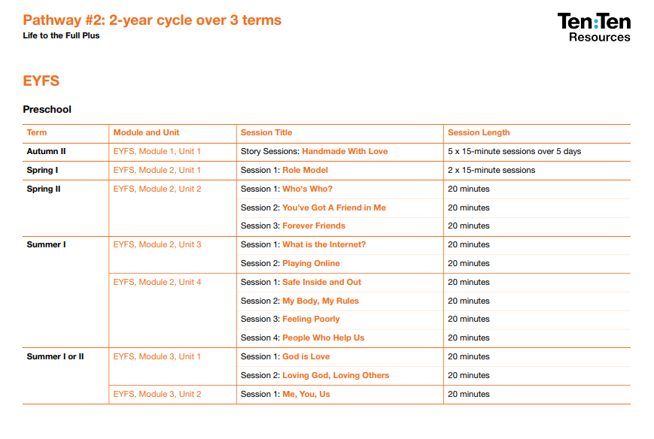
Resources to Support Planning

Slide 9
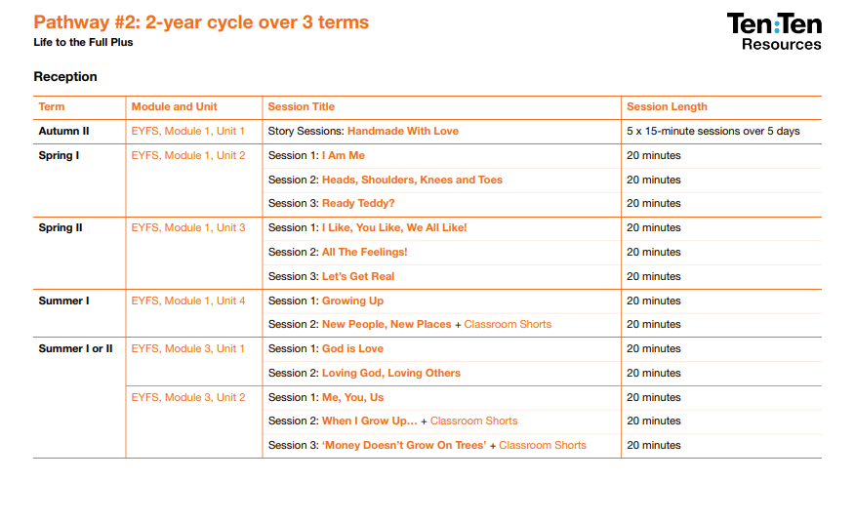

Slide 10
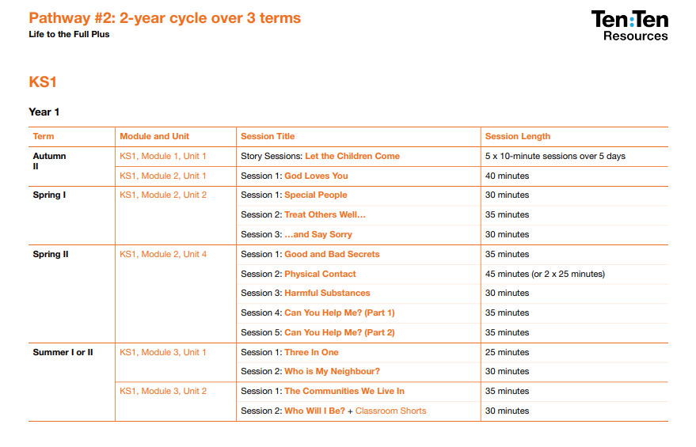

Slide 11
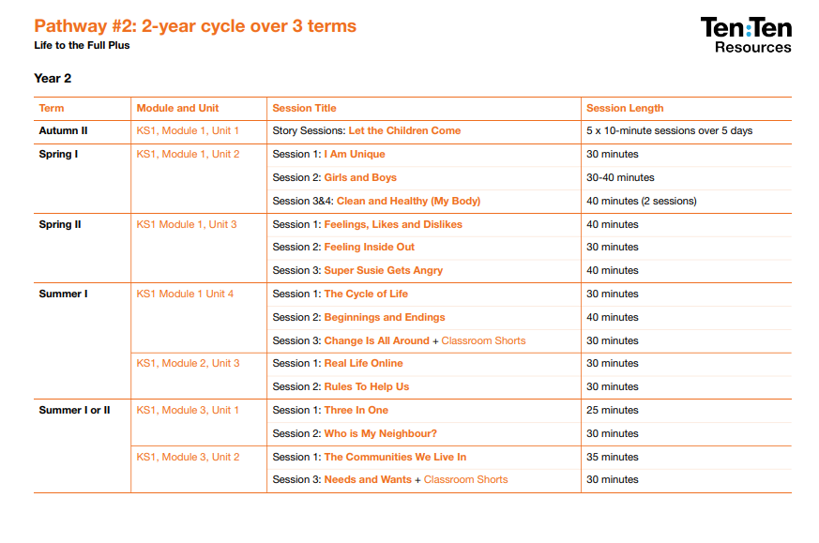

Slide 12
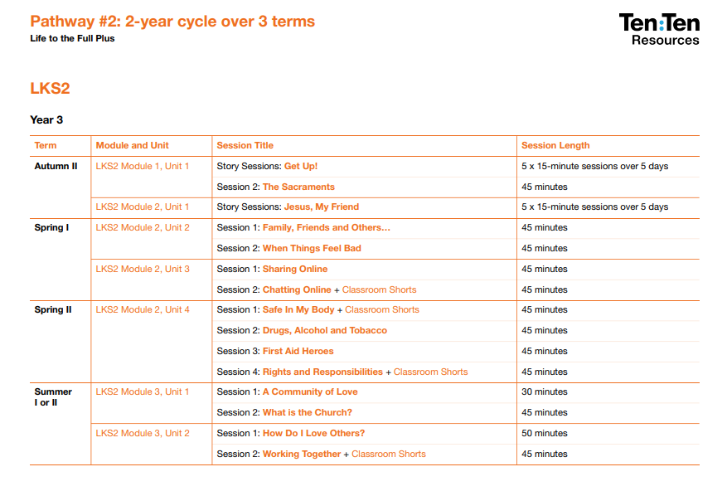

Slide 13
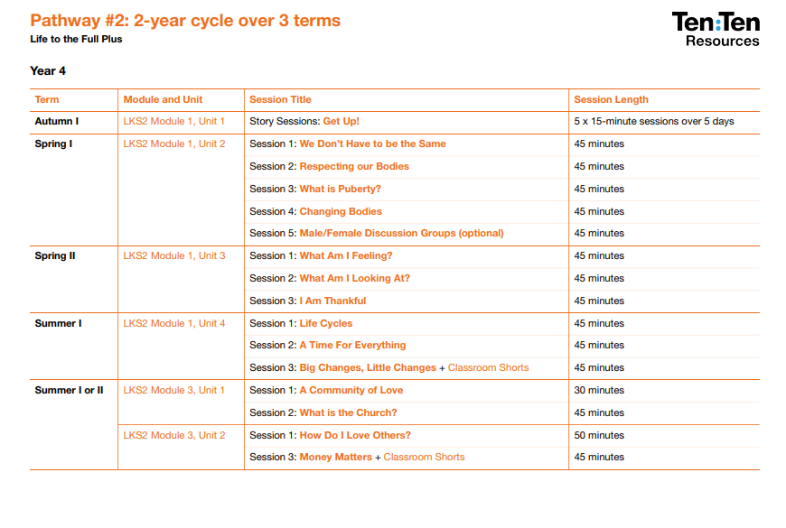

Slide 14
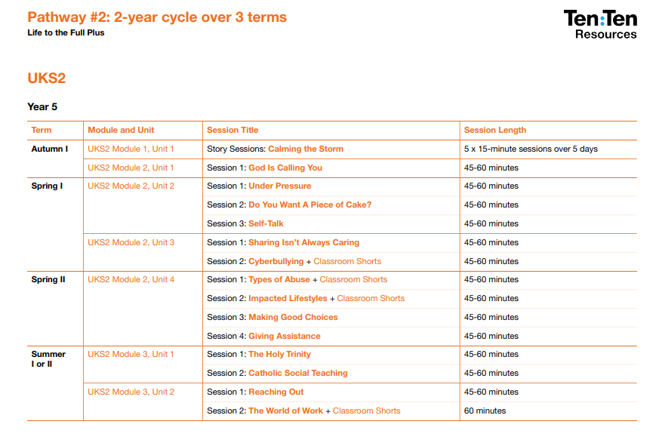

Slide 15
